Slide 1

Route Hive
“Find your way , Own your Time”

Slide 2
ROUTE HIVE
TEAM
Aarogya Ghimire
Basanta Khanal
Ghanashyam Khatri
Shaswat Poudel
Shasank Singh Thakuri

Slide 3
ROUTE HIVE
A web-based system for managing university transportation.
Includes modules for enrollment, route assignment, and notifications.
Supports Admin, Driver, and Student roles with dedicated dashboards.
INTRODUCTION

Slide 4

ROUTE HIVE
Manage and assign bus routes efficiently.
Provide secure, role-based access for all users.
Digitize and optimize university transport services.
OBJECTIVES

Slide 5
ROUTE HIVE
No system for real-time alerts on delays or cancellations.
Paper-based ID cards are prone to damage and slow verification.
No Digital Communication between administration and users.
MOTIVATIONS

Slide 6
ROUTE HIVE
Manual transport causes delays and confusion
A digital platform is needed for smooth management.
Route Hive automates enrollment and simulates bus movement.
From Challenges to Solution

Slide 7
ROUTE HIVE
User Role
Students enroll for transport and can view his bus card and see simulation
Drivers register, log in, and view their profiles
Admins review enrollment forms, approve requests, and assign buses

Slide 8
ROUTE HIVE
Key Features
Secure login with role-based access.
Online enrollment for students and drivers.
Admin dashboard to manage requests and assign buses.

Slide 9
ROUTE HIVE
System Flow Chart
Modular Architecture: System is split into Login, Enrollment, and Dashboard modules for clarity and maintainability.
Role-Based Interaction: Each user role (Admin, User, Driver) interacts with the system through dedicated module flows.

Slide 10
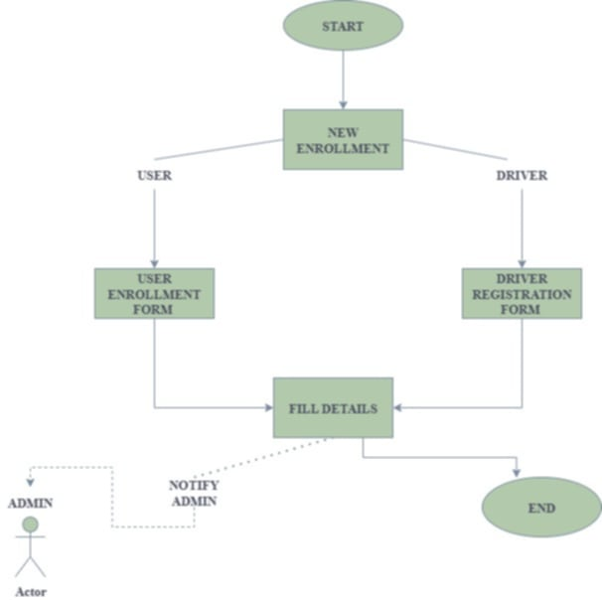
ROUTE HIVE
Enrollment Module

Slide 11
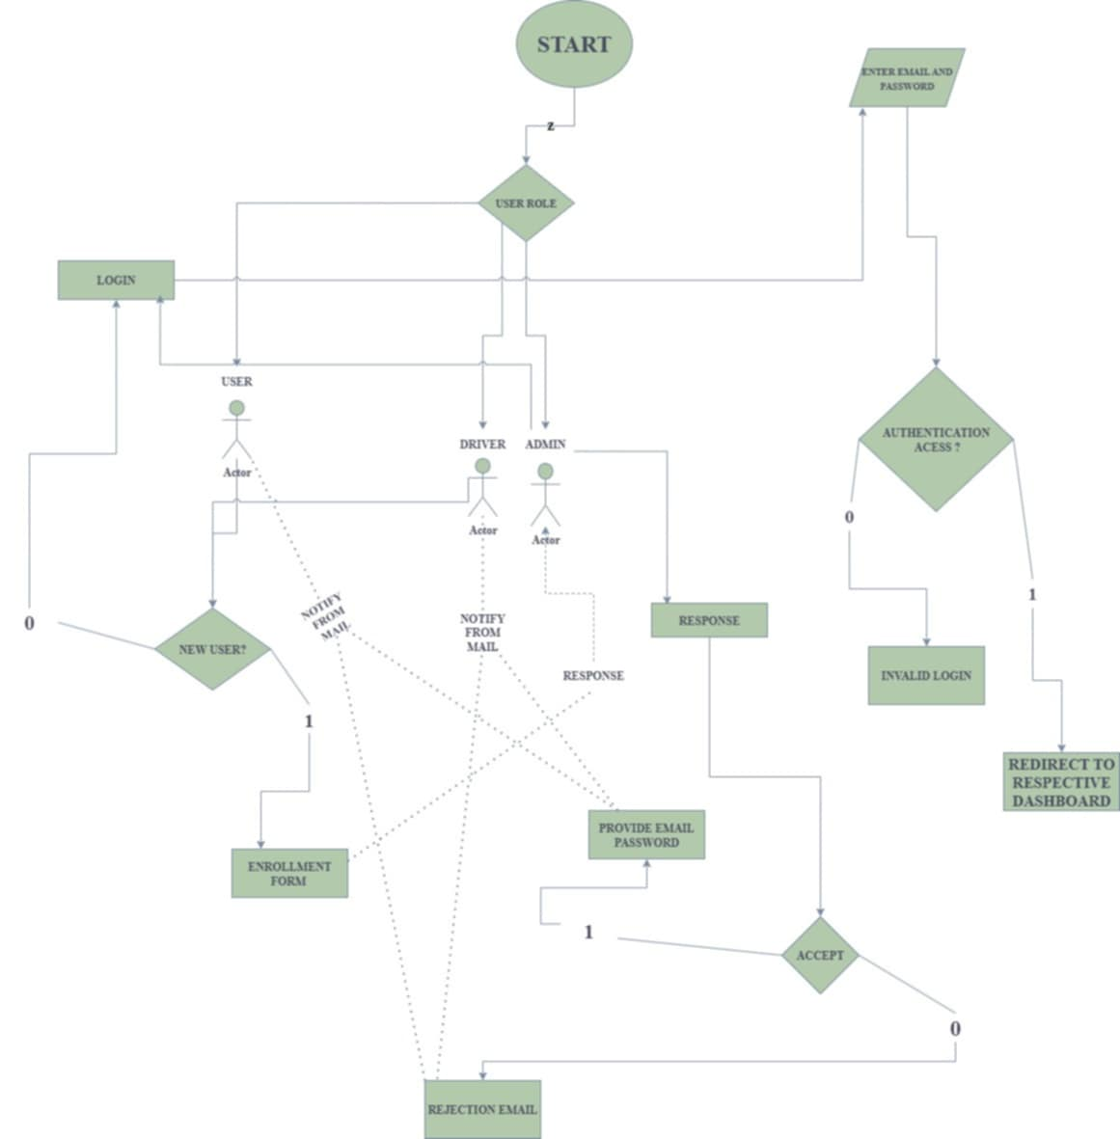
ROUTE HIVE
Login Module

Slide 12
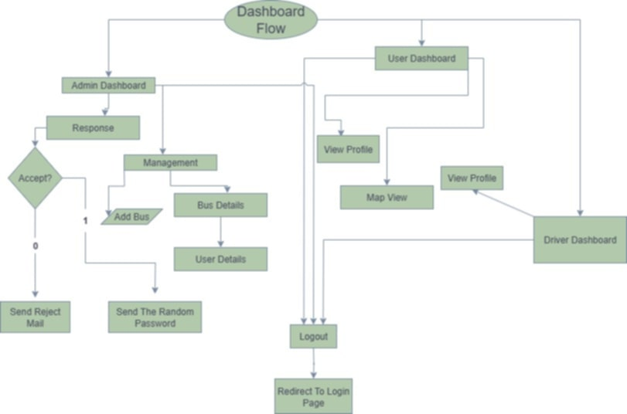

ROUTE HIVE
Dashboard Module

Slide 13
ROUTE HIVE
Route Hive's system flow outlines a structured user journey.
Each module plays a vital role in delivering core features.
However, like all systems, current limitations exist that shape future improvements.
From Blueprint to Boundaries

Slide 14
ROUTE HIVE
Manual Enrollment Process: Admin must verify each application individually.
No Real-Time Communication: No chat or live response system for users.
No Live GPS Tracking: Bus simulation lacks real-time accuracy
Limitation

Slide 15
ROUTE HIVE
Bus Card Has No Expiry Logic: Issued cards don’t have renewal or expiration features yet.
No In-App Notifications: Users don’t get timely alerts on bus arrivals or updates.
No Billing System: Transport fees are not tracked or managed digitally.
Limitation

Slide 16
ROUTE HIVE
Every limitation identified is a stepping stone toward innovation.
Route Hive’s journey doesn’t end here : it’s just the beginning of smarter transport solutions...
Turning Limits into Possibilities

Slide 17
ROUTE HIVE
Mobile Application: Develop apps for Android and iOS for better accessibility.
Bus Card Management: Add expiry and renewal features for transport cards.
Real-Time GPS Tracking: Integrate Live bus location updates for accurate tracking
Future Enhancment

Slide 18
ROUTE HIVE
Communication Module: Enable real-time chat between users, drivers, and admins
Automated Enrollment & Billing: Streamline approvals and implement digital fee management..
In-App Notification System: Provide instant alerts for arrivals, delays, and announcements.
Future Enhancment

Slide 19

ANY QUERIES?

